Slide 1
Identify the Celebrity Look-alikes!
Start the Quiz!
*Based on the popular game show “Dylan McDermott or Dermot Mulroney?” from Saturday Night Live

Slide 2
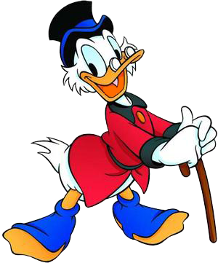
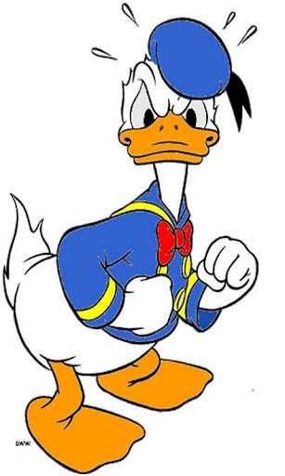
Tutorial Page
Will have animations that highlight how to complete the quiz question.
How to Play
Donald Duck
Scrooge McDuck
Will be mutually exclusive horizontally and vertically. Cannot have both selected in a column or in a row.
Submits the current question, taking the user to the current question’s result page.
Only becomes active when the buttons above are selected.
Will bring user back to this page for the tutorial again. Will not reset progress.

Slide 3
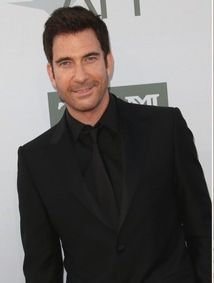
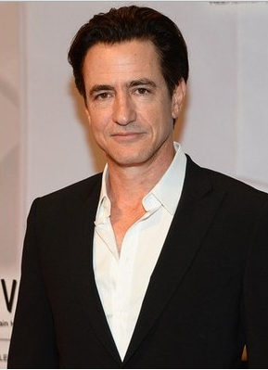
Question #1
Dylan McDermott
Dermot Mulroney
Will be mutually exclusive horizontally and vertically. Cannot have both selected in a column or in a row.
Submits the current question, taking the user to the current question’s result page.
Only becomes active when the buttons above are selected.
Will bring user back to this page for the tutorial again. Will not reset progress.

Slide 4
Question #1 Answer
CORRECT / INCORRECT
Dylan McDermott
Dermot Mulroney
Submits the current question, taking the user to the current question’s result page.
Only becomes active when the buttons above are selected.

Slide 5
Quiz Summary
Question | Result
#1 | ✓
#2 | ✗
#3 | ✓
#4 | ✗
#5 | ✓
Total | 3 / 5

